Slide 1

HealthConnectPro..
CS691 FALL 2023 PROJECT TEAM
Kelly liu
Nikhil Bhosale BHAU
Tiara Hammond
Mukesh Laudya
Kamesh Nalla
Nikhil Kumar Ratakonda
Vivek Vinay Somani
Dhanusha Veluvolu

Slide 2
GitHub URL
https://github.com/nikhilScaleup/HealthConnectPro/tree/nikhil_bhosale_dev

Slide 3
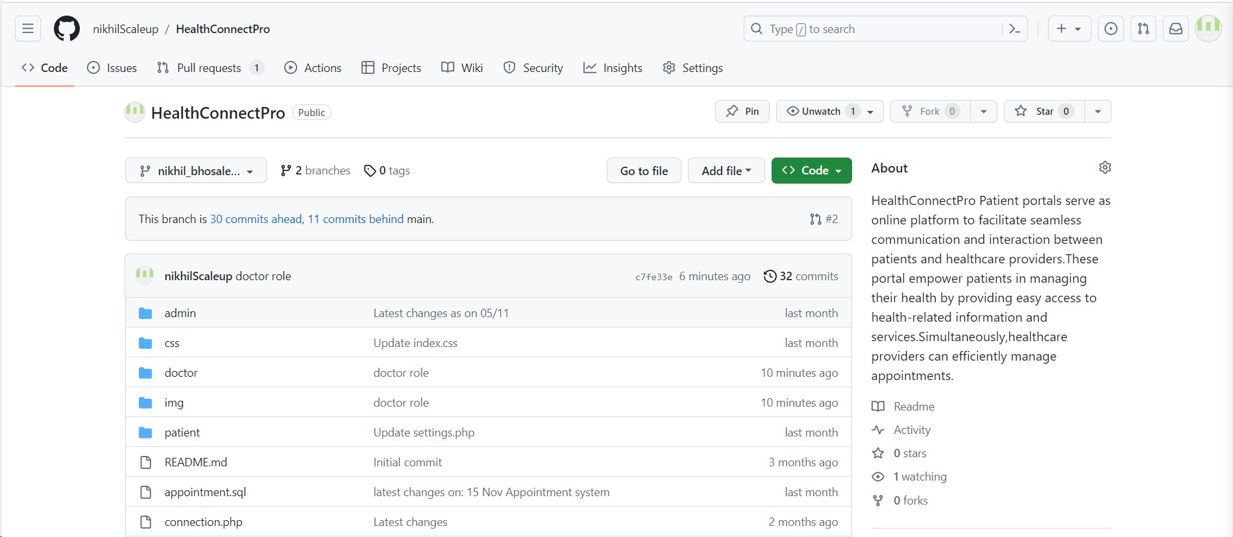
Repository Structure

Slide 4
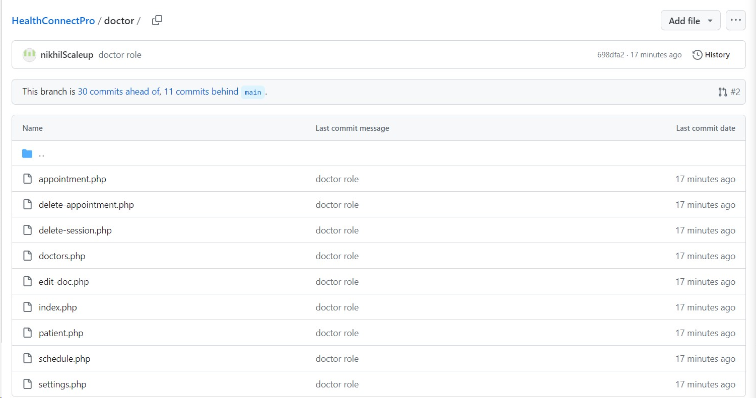
Feature – Doctor Module

Slide 5
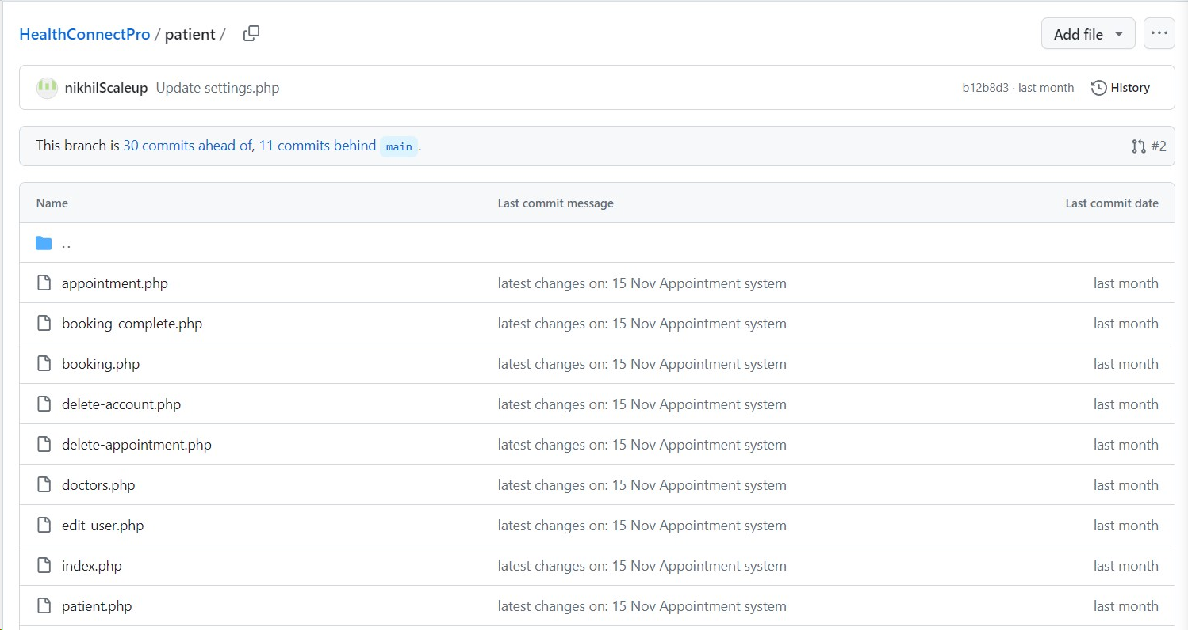
Feature – Patient Module

Slide 6
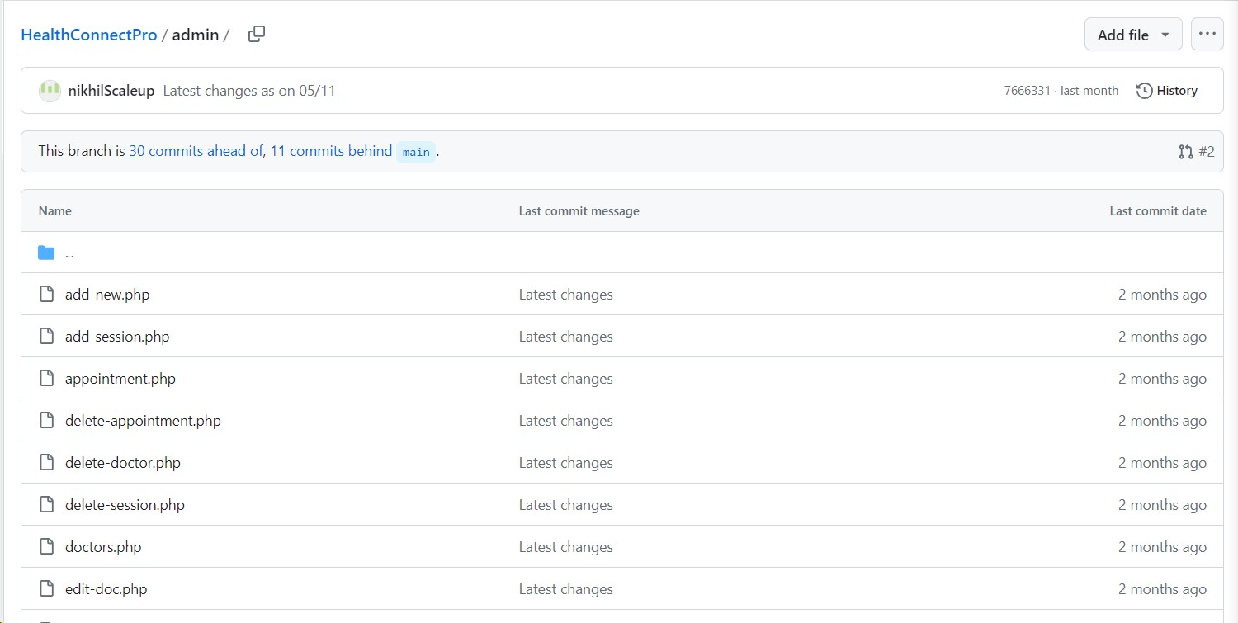
Feature – Admin Module

Slide 7
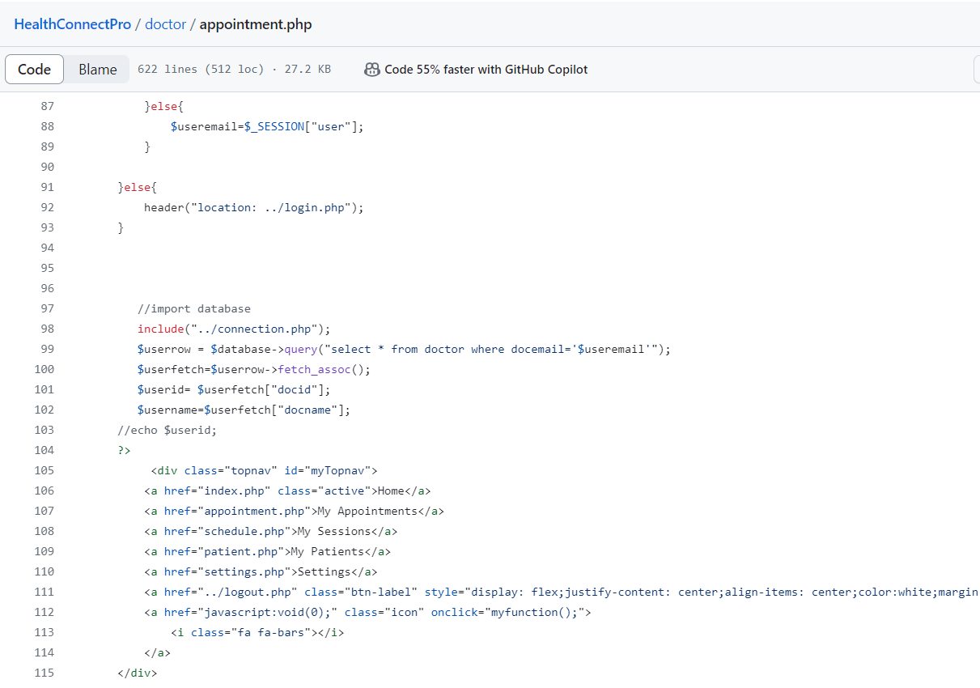
FEATURE – APPOINTMENT

Slide 8
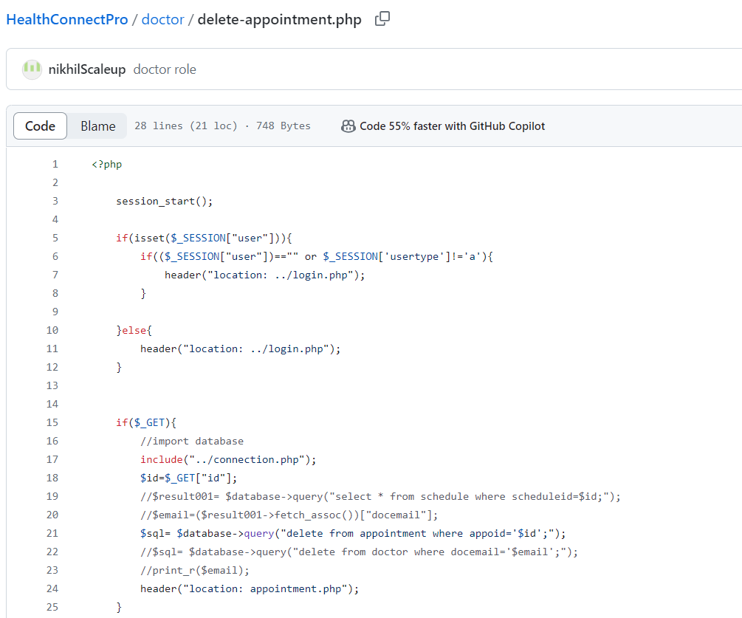
Feature -Cancel Appointment

Slide 9
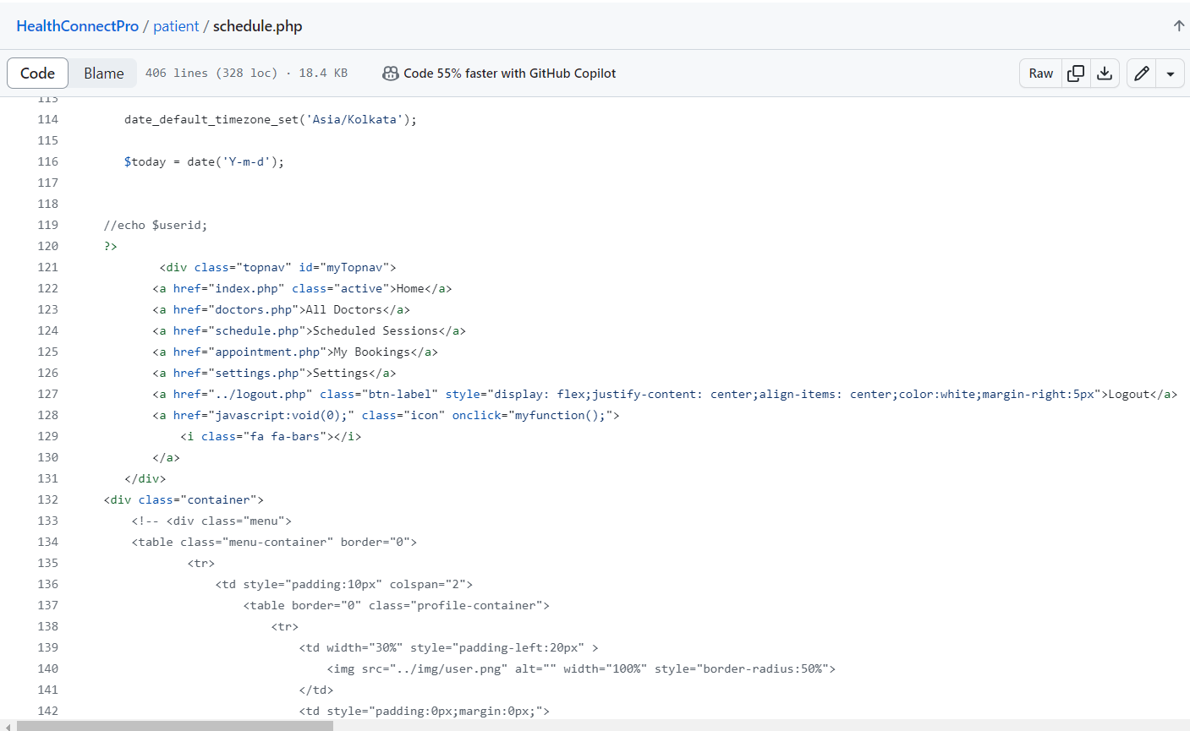
Feature -Delete Appointment

Slide 10
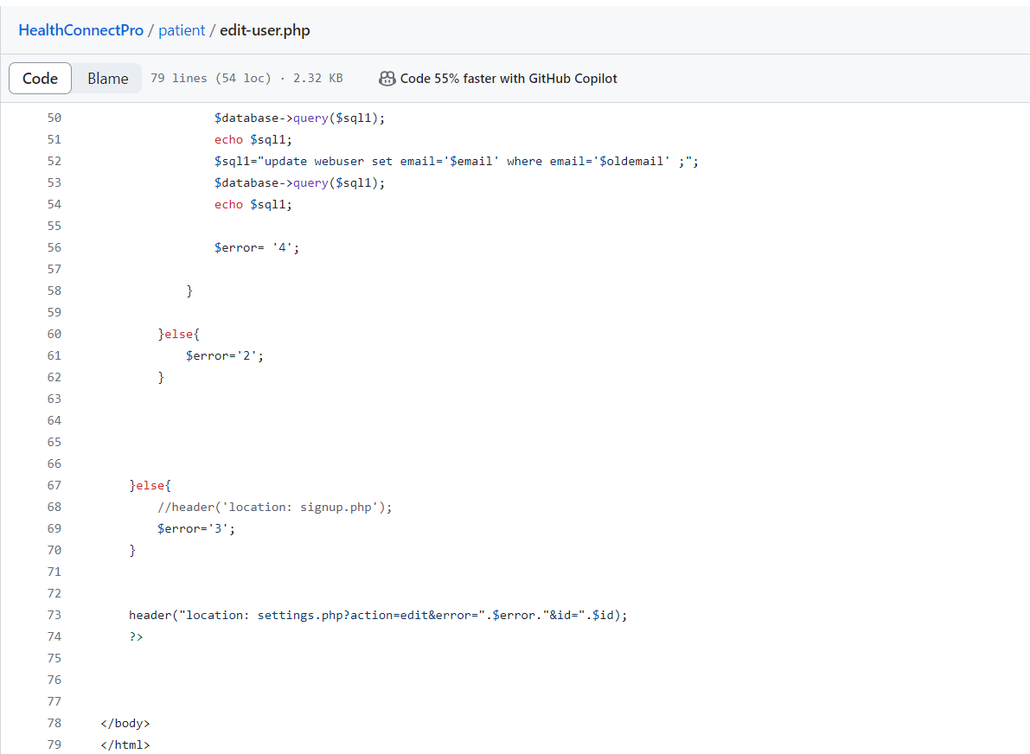
Feature – Edit user

Slide 11
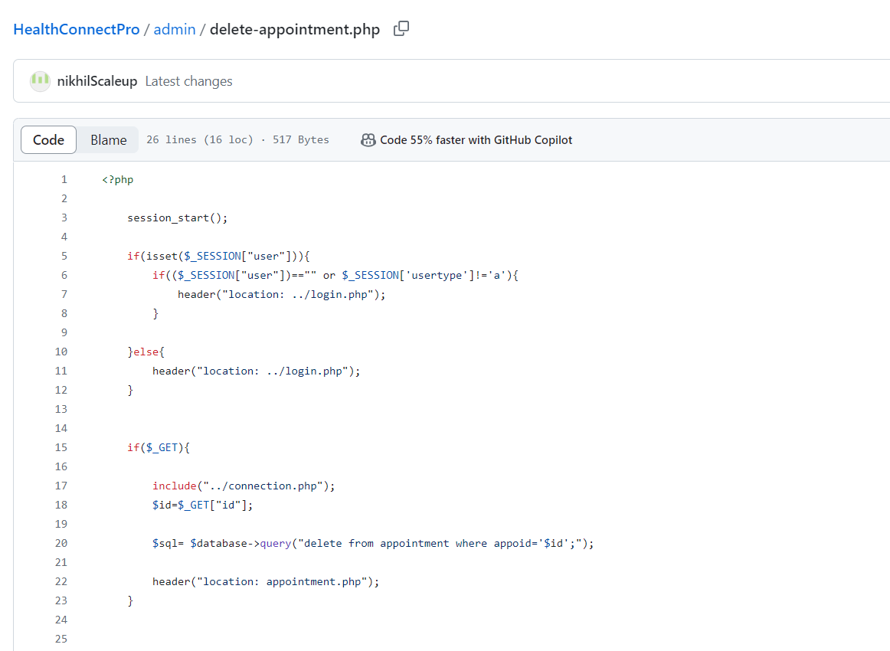
Feature – Delete Appointment from Database

Slide 12
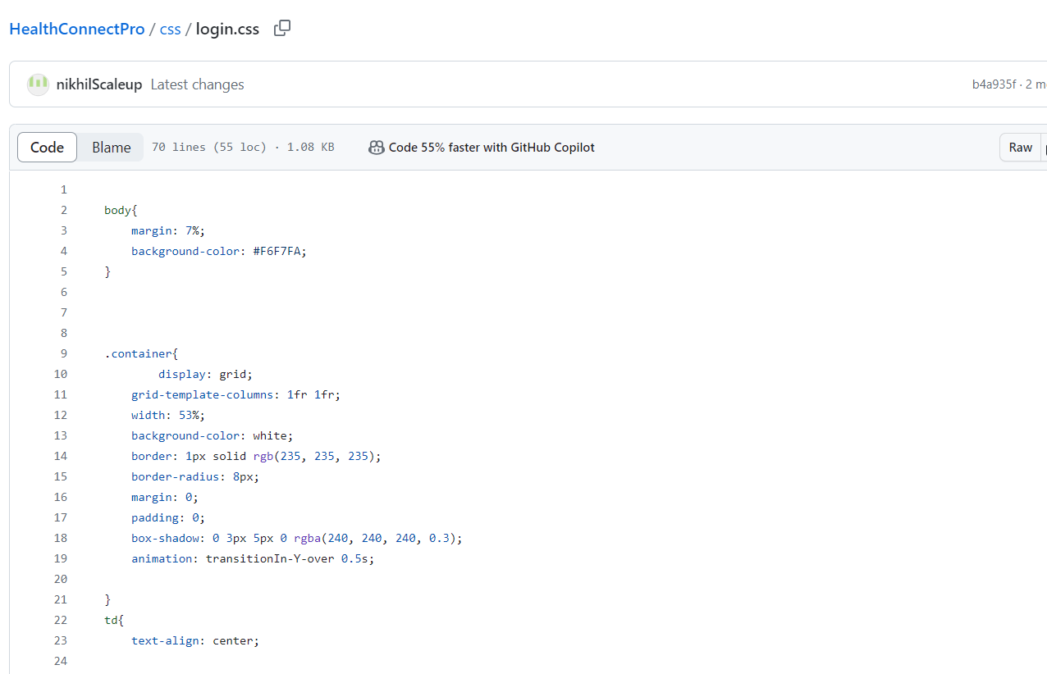
Feature – Login Page CSS styling

Slide 13
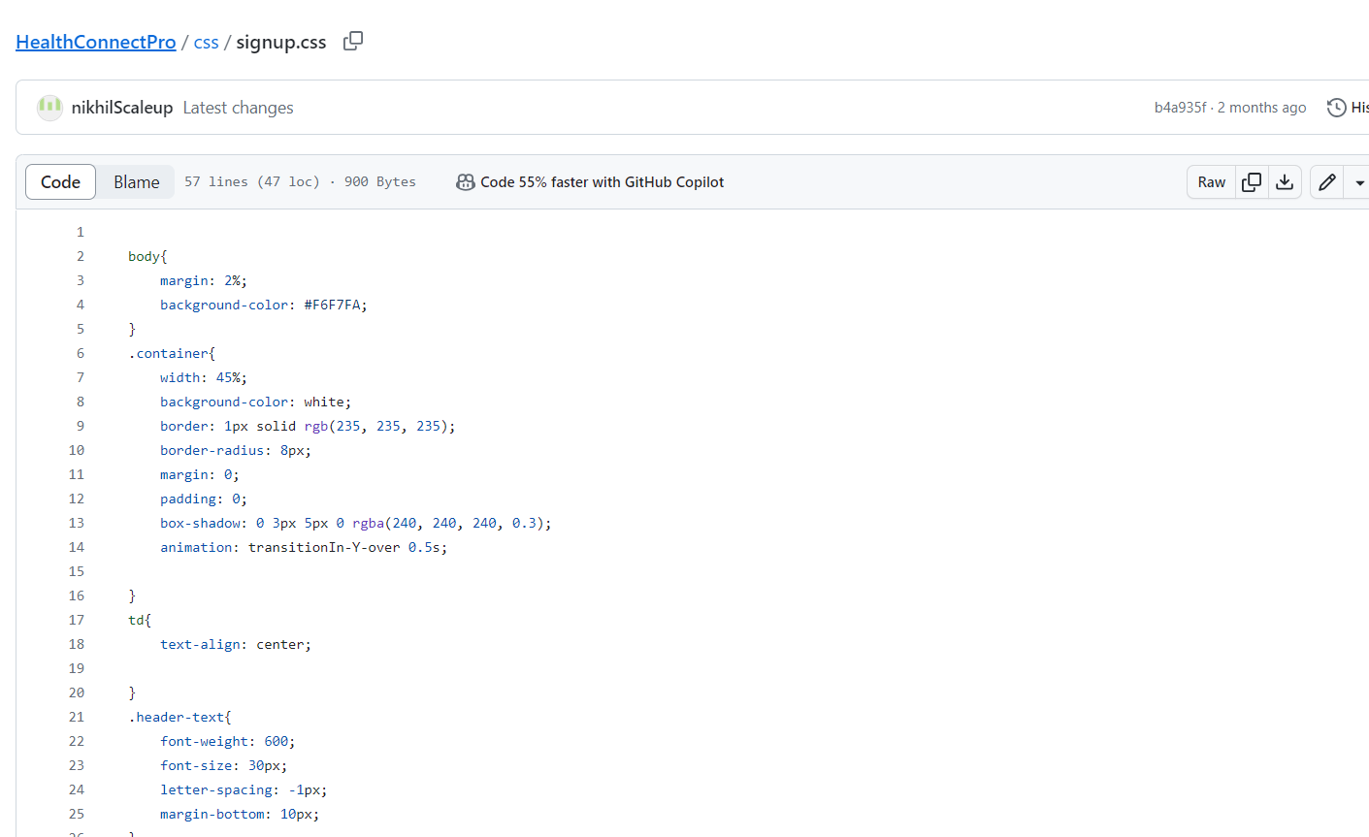
Feature - Signup CSS styling

Slide 14
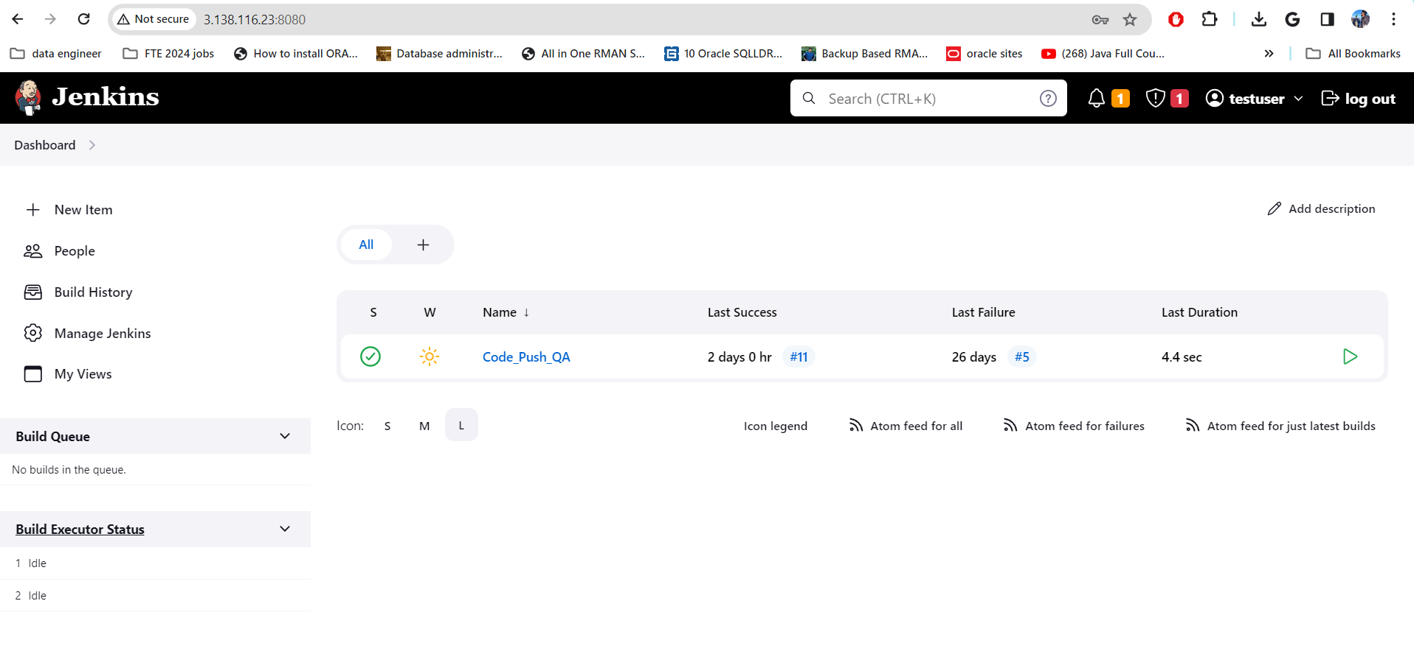
Build & Deployment on AWS Using Jenkins

Slide 15
Thank you!!

